Slide 1
Next up:
Speaker’s name
Notes:
Dear speaker,
your session will be recorded and published (unless otherwise agreed).
Please ensure that:
Your screen resolution is set to 1920x1080 pixels.
Your device should have a (full size) HDMI output. You're welcome to bring a proper dongle for your device, if this connection is missing.
Your device must not provide protected output such as HDCP (especially important for MAC users).
Start the countdown (slides 2-4) IMMEDIATELY BEFORE you talk to the audience!
The countdown is important in terms of video editing after the conference. The published session will start with slide 5. Feel free to remove slide 1-4 before you upload the slides to the conference repository.
Good luck! 💙

Slide 2
3
Notes:
[REQUIRED SLIDE]

Slide 3
2
Notes:
[REQUIRED SLIDE]

Slide 4
1
Notes:
[REQUIRED SLIDE]

Slide 5
Session title
Speaker’s name

Slide 7

Many thanks to our sponsors:

Slide 8

Speaker name
Your bio
You can download your shield here:
Speakers shields
If any problem with you shield, please contact us at contact@psconf.eu

Slide 9
Slide title
Sample text for your PSConf.EU 2022 presentation
We usually prefer demos, use slides with moderation
Think about those at the back of the room, some text might be too small.
Think about accessibility, try to improve the contrast, colours and size of your presentation.

Slide 10
Instructions
Use this template if you want, it’s preferred but not mandatory.
Please make sure our sponsors are mentioned on your first slide after the title.
Do not amend the ratio or the colours of the sponsors’ logo and background.
Update your twitter handle through the master page (see next slides).

Slide 11
Instruction (Continued)
The session is 30 min.
Then 15min Q&A.
At the end of your 45 min, please leave the room to the next speaker.
You’re welcome to continue the discussion in the Foyer area.

Slide 12
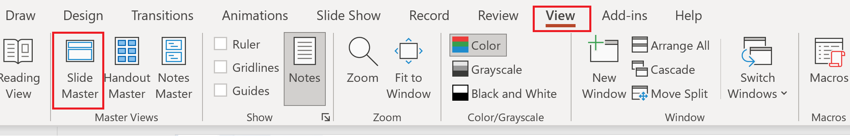
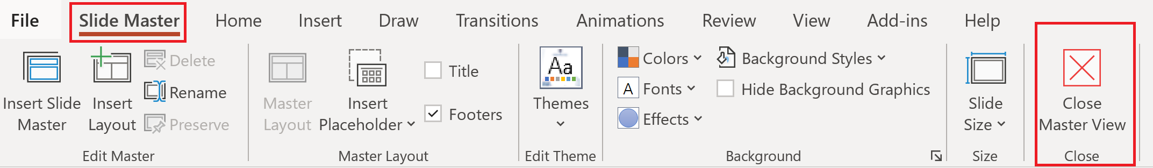
Update the twitter handle on the master slide
To open the slide master:
To close the Master view:
If you need any help, do not hesitate to email us at psconfeu@synedgy.com

Slide 13
Demos
We love Demos!

Slide 14
Q&A
15 minutes

